Slide 1

Predictive Maintenance:
Journey Mapping
University Brainstorming Project
October 23, 2026

Slide 2

What is predictive maintenance?
Condition-based maintenance uses live equipment data and analytics to predict failure before it occurs—so intervention happens at the right moment.
MACHINE
DATA
ACTION

Slide 3

Value shows up on the floor
Earlier signals turn uncertainty into planned, safer work.
↓ DOWNTIME
$ COST
Fewer unplanned stops
Avoid secondary damage
↗ CAPACITY
SAFETY
Use people and parts well
Act before risk escalates

Slide 4
From reaction to anticipation
01
02
03
REACTIVE
PREVENTIVE
PREDICTIVE
Fix after failure
High disruption
Service by schedule
Some unnecessary work
Act on condition
Right work, right time

Slide 5
Map the work through four lenses
Journey mapping makes handoffs, interactions and ownership visible across the end-to-end maintenance process.
MG
Manager
OP
Operator
JOURNEY
Observe • Map • Reframe
DA
Data Analyst
MT
Technician

Slide 6

Current maintenance journey
Manual handoffs create delay between the first weak signal and completed repair.
Operate
Notice issue
Report
Diagnose
Schedule
Repair

Slide 7
Four people. One shared outcome.
OP
MT
DA
MG
OPERATOR
TECHNICIAN
DATA ANALYST
MANAGER
Monitors machines daily
Performs repairs
Interprets sensor data
Guides maintenance strategy

Slide 8

Where the current journey breaks
01
Unexpected downtime
02
Delayed failure detection
03
Data silos + weak handoffs
04
Inefficient scheduling

Slide 9

Every asset leaves a data trail
Touchpoints along the journey convert physical behavior into observable signals.
Vibration
Temperature
Pressure
Acoustic
Thermal imaging

Slide 10
Raw signals become decisions
A governed pipeline turns machine behavior into a recommendation people can trust.
DATA
ACQUISITION
PREPROCESSING
ANALYTICS / AI
DECISION
SUPPORT
Collect → clean → learn → act

Slide 11
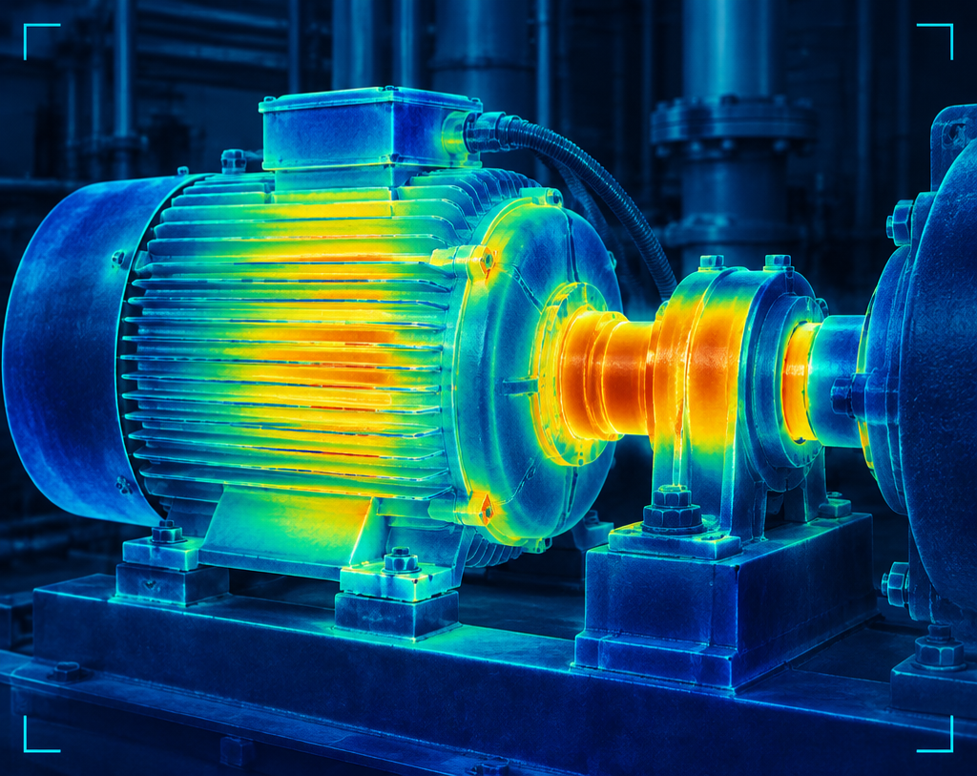
See condition—not just status
Continuous capture, threshold logic and trend analysis reveal change while there is still time to act.
CONTINUOUS
Capture every meaningful shift
THRESHOLDS
Escalate the right signal

Slide 12
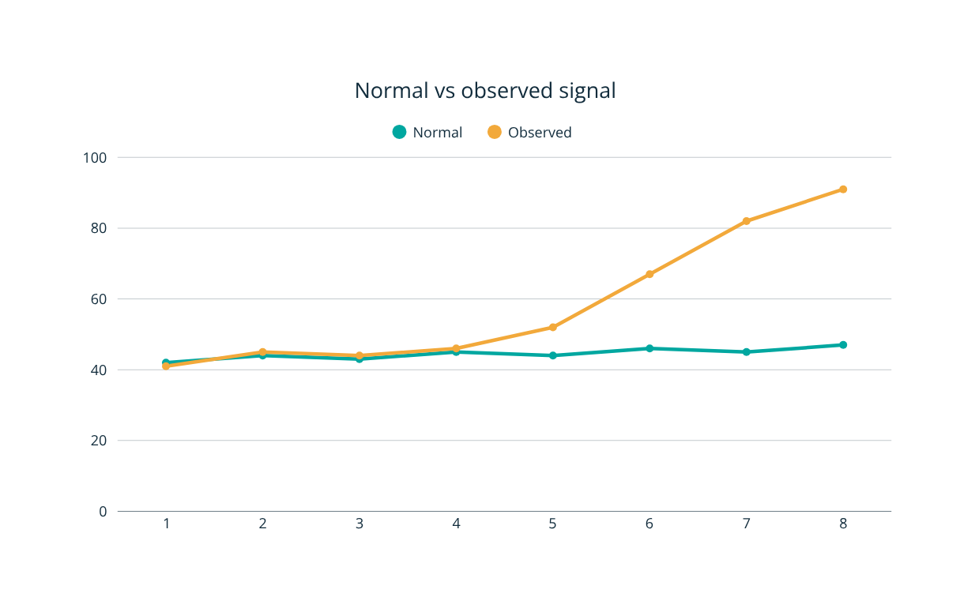

AI finds the pattern break
Anomaly detection learns normal multivariate behavior, then flags deviations that fixed thresholds can miss.

Slide 13
How much useful life remains?
RUL estimates the operating window before likely failure—shifting the question from “what is wrong?” to “when should we intervene?”
NOW
WATCH
PLAN
INTERVENE

Slide 14
An alert is the start—not the outcome
The decision journey must preserve context, ownership and urgency.
ANOMALY
DETECTED
ALERT
GENERATED
OWNER
NOTIFIED
RISK
REVIEWED
ACTION
APPROVED
Signal → context → accountability → decision

Slide 15

Execution closes the loop
Timely response converts prediction into operational value.
01 Create work order
02 Dispatch technician
03 Repair asset
04 Verify condition

Slide 16
Every repair makes the system smarter
Outcomes validate data, tune models and refine the maintenance process.
MAINTENANCE
OUTCOME
LEARN
& IMPROVE
PROCESS
REFINEMENT
DATA
VALIDATION
MODEL
TUNING

Slide 17
Future-state: signal to action, seamlessly
Integrated AI and automated orchestration reduce delay while keeping people in control.
SENSE
PRIORITIZE
VERIFY
PREDICT
ORCHESTRATE
LEARN
Fewer handoffs • Faster decisions • Better experience

Slide 18

Where might we innovate?
Use the journey to focus brainstorming on the moments with the greatest friction and value.
01
Denser sensor networks
02
Real-time mobile alerts
03
Smarter analytics dashboards
04
Cross-team collaboration

Slide 19
Measure value. Scale with intent.
DOWNTIME
COST
ALERTS
TECHNICIANS
Reduction %
Savings
Accuracy
Utilization
PILOT
0–3 months
SCALE
3–12 months
OPTIMIZE
12+ months

Slide 20

Map the journey.
Move before failure.
01 Predictive maintenance creates measurable value.
02 Journey mapping exposes stakeholders and friction.
03 Data turns signals into proactive action.
04 Feedback sustains continuous improvement.
What should we prototype first?

